Slide 1
Data Structures and Algorithms -3 (25CS2103E)
Multi-Pattern Search Engine Using Aho–Corasick Algorithm
Team Members
Dharmika P : 2520030012
Parinita T : 2520030562
Darshini Gangisetti : 2520030167
Under the Esteemed Guidance of
Mrs. J. Yamini Devi
Assistant Professor, CSE

Slide 2
Contents
Abstract
Introduction
Literature survey
Problem Statement and Objectives
Hardware and Software requirements
Results
Conclusion
Future Scope

Slide 3
Abstract
The Multi-Pattern Search Engine is designed to efficiently search multiple patterns or keywords within a given text or document. It uses the Aho–Corasick algorithm, which builds a Trie structure and uses failure links to search all patterns simultaneously in a single scan of the text. This approach improves search efficiency compared to searching for each pattern separately. The system can identify matched patterns and their positions in the input text. It can be useful in applications such as text searching, spam filtering, plagiarism detection, DNA sequence analysis, and keyword filtering.

Slide 4
Introduction
Searching for multiple keywords in a large amount of text is an important problem in computer science. Traditional searching methods search for each pattern individually, which can take more time when many patterns are involved.
The Aho–Corasick algorithm solves this problem by combining all patterns into a Trie and creating failure links. The text is scanned only once, and all matching patterns are found efficiently.

Slide 5
Literature Survey
Naive String Matching: Searches each pattern separately and can be slow for multiple patterns.
KMP Algorithm: Efficiently searches for a single pattern but is not primarily designed for multiple patterns together.
Rabin–Karp Algorithm: Uses hashing for pattern matching but may have hash collisions.
Aho–Corasick Algorithm: Efficiently searches multiple patterns simultaneously using a Trie and failure links.

Slide 6
Problem Statement and Objectives
Problem Statement
Traditional search methods become inefficient when multiple patterns need to be searched in a large text. An efficient system is required to detect all patterns in a single scan.
Objectives
To accept multiple search patterns.
To construct a Trie from the patterns.
To build failure links.
To scan the input text efficiently.
To identify all matched patterns and display their positions.

Slide 7
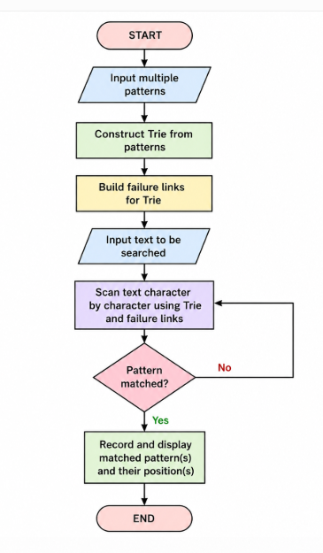
Flow Chart

Slide 8
Results
The system successfully searches for multiple patterns in the given text using the Aho–Corasick algorithm. All matching keywords are detected along with their positions.
Example
Input Text: ahishers
Patterns: he, she, his, hers
Output: Pattern "his" found
      Pattern "she" found
      Pattern "he" found
      Pattern "hers" found

Slide 9
Hardware and Software requirements
Hardware Requirements
Computer/Laptop
Minimum 4 GB RAM
Intel i3 processor or equivalent
Keyboard and Monitor
Software Requirements
Operating System: Windows/Linux
Programming Language: Python
IDE: VS Code or PyCharm
Python libraries for implementation

Slide 10
Conclusion
The Multi-Pattern Search Engine using the Aho–Corasick algorithm provides an efficient method for searching multiple patterns simultaneously. By using a Trie and failure links, the algorithm scans the text efficiently and detects all possible matches. It is suitable for applications involving large text data and multiple keyword searches.

Slide 11
Future Scope
Search patterns in multiple documents.
Add a graphical user interface.
Support case-insensitive searching.
Add wildcard and fuzzy pattern matching.
Use the system for plagiarism detection and spam filtering.
Apply it to DNA and biological sequence analysis.

Slide 12
Thank you

